Slide 1
Customer Segmentation using RFM model
RFM analysis allows marketers to target specific clusters of customers with communications that are much more relevant for their particular behavior – and thus generate much higher rates of response, plus increased loyalty and customer lifetime value.

Slide 2
What are Recency , Frequency and Monetary?
Recency: How much time has elapsed since a customer’s last activity or transaction with the brand? Activity is usually a purchase, although variations are sometimes used, e.g., the last visit to a website or use of a mobile app. In most cases, the more recently a customer has interacted or transacted with a brand, the more likely that customer will be responsive to communications from the brand.
Frequency: How often has a customer transacted or interacted with the brand during a particular period of time? Clearly, customers with frequent activities are more engaged, and probably more loyal, than customers who rarely do so. And one-time-only customers are in a class of their own.
Monetary: Also referred to as “monetary value,” this factor reflects how much a customer has spent with the brand during a particular period of time. Big spenders should usually be treated differently than customers who spend little. Looking at monetary divided by frequency indicates the average purchase amount – an important secondary factor to consider when segmenting customers.

Slide 3
Data Analysis
Max Revenue by a customer- 34847.4
Min Revenue by a customer-38.5
Max Orders by a customer-156
Min Orders by a customer-1

Slide 4
TOP 5 CUSTOMERS WITH MAX REVENUES
CustID Revenue
2266 - 34847.4
2876 - 32486.98
2267 - 24178.97
1153 - 18554.49
3377 - 16884.99

Slide 5
CUSTOMER SEGMENTATION
CHAMPIONS=RFM score>4.5
HIGH VALUE CUSTOMERS = RFM score >4
MEDIAM VALUE CUSTOMERS = RFM score >3
LOW VALUE CUSTOMERS=RFM score>1.6
LOST CUSTOMERS=RFM score <1.6

Slide 6
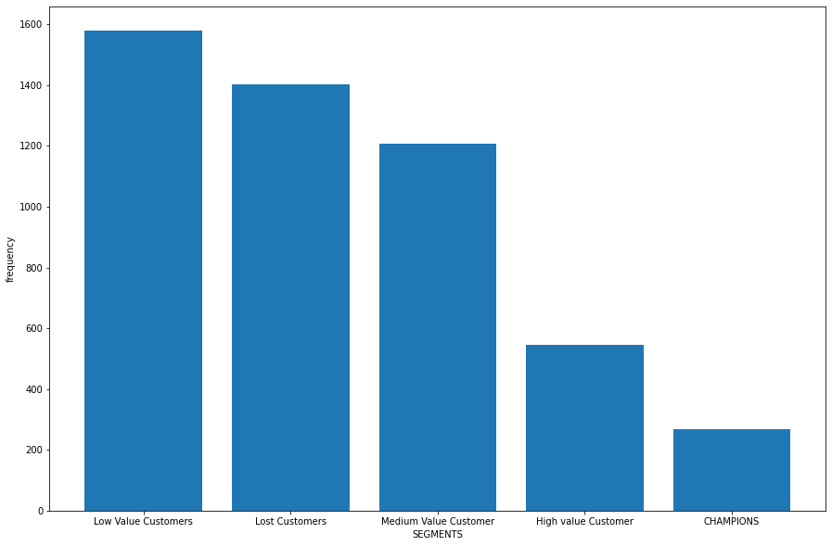
Count of segments
CHAMPIONS=268
HIGH VALUE CUSTOMERS = 545
MEDIAM VALUE CUSTOMERS = 1206
LOW VALUE CUSTOMERS=1402
LOST CUSTOMERS=RFM score <1579

Slide 7
